Slide 1
Lab 16 File and Directory
Professor: Hsung-Pin Chang
Operating System Lab

Slide 2
Introduction (1/3)
An efficient method to access our data in any permanently storage – file system.
File :
Data unit
Related information for management
The smallest storage unit :block
A block is composed of one or more sectors.
How to decide the size of blocks, larger or smaller ?
File-System provides :
Mapping from the logical file system to disk.
Access operations and related attributes of each file.

Slide 3
Introduction (2/3)
VFS
The purpose of VFS is to allow applications to access different types of concrete file systems in an uniform way.
VFS provides an interface between kernel and file systems.
VFS separates the detail implementation from kernel operations.
It is easy to add support for new file system types.

Slide 4
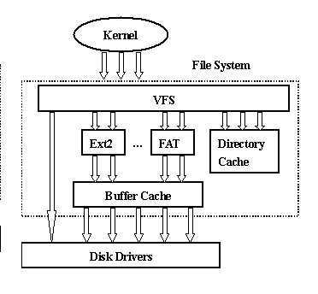
Introduction (3/3)

Slide 5
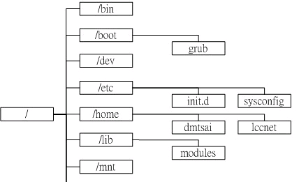
Linux File System (1/5)
Linux EXT2 file system
Each file includes two parts : i-node and data
The kernel identifies all files by i-nodes
i-node contains:
Related attributes to each file.
Pointers to real data blocks.
A directory is also a file , that it contains a list of name and i-node number of files.
i-node
owner
permission
access time
flags
size
Pointers to blocks

Slide 6
Linux File System (2/5)
Glance at Linux file system (ext2) structure :
Super block
i-node bit map
block bit map
i-node table
Data blocks
data blocks
i-node table

Slide 7
Introduction of File System (3/5)
Super block (partition control block)
Counters of the free/used blocks and i-nodes
Default size of each block and i-node
Valid bit : the system is mounted or not.
block / i-node bit map
Record the usage of blocks / i-nodes
i-node table (file control block)
Information of each i-node

Slide 8
Introduction of file system (4/5)
Links :
Hard link :
Hard-link only adds one item into a directory entry.
Making hard-link to directory is prohibited on Linux file system.
data blocks
dir
i-node table
A
B
new item added
C

Slide 9
Introduction of File System (5/5)
Symbolic link :
In this case, using symbolic link will create a new file contains the destination file name.
data blocks
i-node table
Data : file name
New i-node
New data

Slide 10
Operation for Directory File
Functions :
#include <dirent.h>
DIR *opendir( const char *pathname);
struct dirent *readdir (DIR *dp);
int closedir (DIR *dp); …

Slide 11
opendir()
This function opens a directory stream and returns a DIR pointer .
Open a directory stream of a directory for related operations.
This stream contains a list of (name ,i-node num) in pathname directory.
#include <dirent.h> DIR *opendir( const char *pathname);

Slide 12
readdir()
Get information from a DIR stream :
It returns the next name and i-node number in this stream in a dirent structure.
struct dirent { ino_t d_ino; // i-node num char d_name[]; } // file name
#include <dirent.h> struct dirent *readdir (DIR *dirptr);

Slide 13
closedir()
A function to close a DIR stream
Close this directory data stream dirptr
Returned value ,0 if success and -1 on error
#include <dirent.h> int closedir (DIR *dirptr);

Slide 14
stat()& lstat()
We can use these function to get information about a file :
It returns the information of pathname and stored it into buf.
lstat() is specified to get information about “link”
It returns the status about “link” itself.
return value ,0 if ok and -1 on error.
#include <sys/stat.h> int stat (char *pathname, struct stat *buf); int lstat (char *pathname, struct stat *buf);

Slide 15
stat()& lstat() (cont.)
struct stat {
mode_t st_mode; /*file types and mode*/
ino_t st_ino; /*i-node number*/
dev_t st_dev; /*device number*/
dev_t st_rdev;
nlink_t st_nlink; /*number of links*/
uid_t st_uid; /*user ID of owner*/ gid_t st_gid; /*group ID of owner*/ off_t st_size; /*size in bytes*/
time_t st_atime; /* time */ time_t st_mtime; time_t st_ctime; blksize_t st_blksize; /*block size*/ blkcnt_t st_blocks; /*block numbers*/
}

Slide 16
utime()
The access time (st_atime) and modification time (st_mtime) of a file can be changed with the utime() function.
You must have the right to access this file.
st_ctime ,i-node change-status time, is protected.
If *times is a NULL pointer, it sets (atime, mtime) to the current time.
#include <utime.h> int utime (const char *pathname, const struct utimbuf *times);
struct utimbuf { time_t actime; /* st_atime */ time_t modtime; /*st_mtime*/ }

Slide 17
Example
Make a symbolic link
Try to use lstat() and stat() to get information about this link and show the difference.
Size of the file and its type.

Slide 18
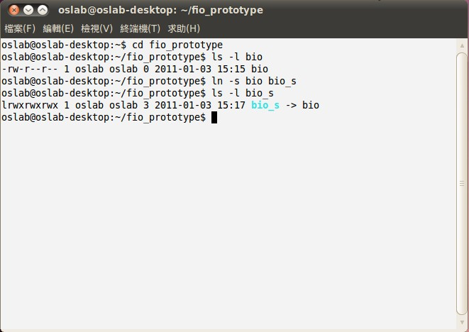
ls

Slide 19
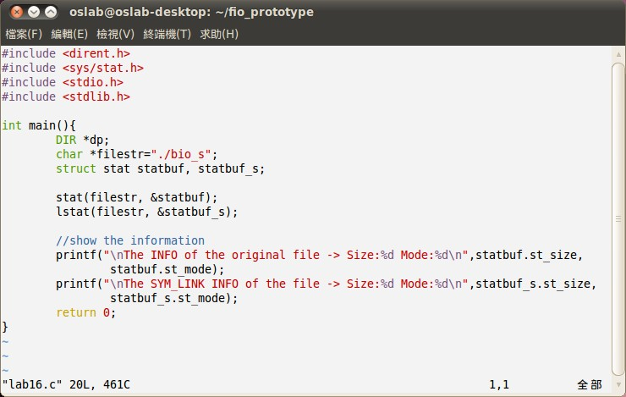

Slide 20
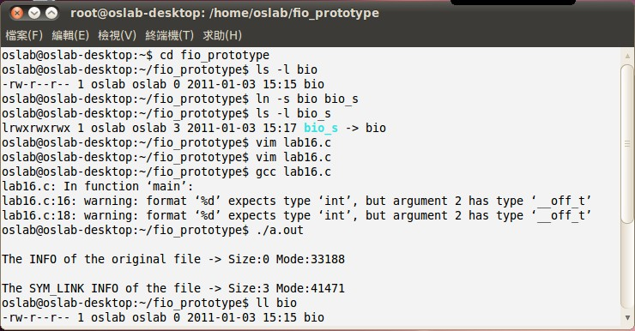

Slide 21
Exercise
A directory scan program :
Create a testing directory contains four files.
This program will scan this directory and show file names on screen.

Slide 22
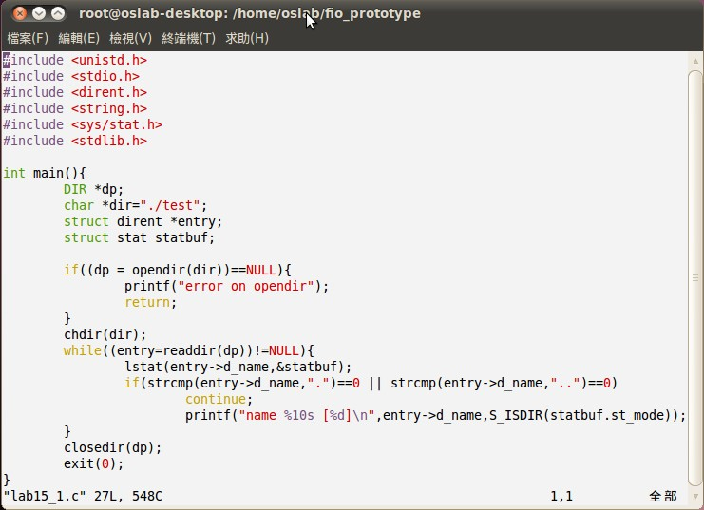
Exercise (cont.)
Open a directory stream
Read each file name from stream. No “.” and “..” directory names

Slide 23
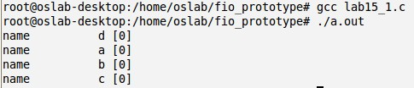
Exercise (cont.)
This is the result of the exercise.

Slide 24
Reference
Advanced Programming in the UNIX Environment 2nd Author : Richard Stevens, Stephen A.Rago, Publisher : Addison-Wesley
Beginning Linux Programming Author : Richard Stones, Neil Matthew Publisher : Wrox
http://linux.vbird.org/
http://www.jollen.org/blog/ jollen’s Blog
Operating System Concepts 8th

